Slide 1
Freud’s Psychoanalysis: Beneath Consciousness
Psychoanalysis Formally started in 1895, when Freud – with his colleague Breuer – published “Studies on Hysteria,” which marked to beginning of Freud’s own clinical studies.
Based in clinical observations, not laboratory observations, psychoanalysis represents a separate paradigm for understanding the causes of human behavior.
In terms of timeframe, the rise of psychoanalysis occurred at the same time of rise of behaviorism, but psychoanalysis was more popular with the public and clinicians than with the researchers.

Slide 2
Sigmund Freud (1856-1939)
Freud’s initial genius was in his bringing together of many diverse approaches to understanding the function of the mind.
Freud’s broad-based intellectual interests contributed to his extraordinary theories. A true scholar, Freud was interested in evolution theory, irrational behavior, sexuality, internal conflicts, and many other areas – He attempted to bring them all together.

Slide 3
Forerunners of Freudian Concepts
It was during the 18th century that Leibnitz developed a theory of Monads to explain point of focus or energy (similar to Freud’s notion of Libido).
Friedrich Nietzshe (1844 – 1900) described the
human being is basically an animal, but in order to function within civilized society, much of our raw animal nature must be kept under wraps (remain in the unconscious).
Concerning the expression of aggression, it was Nietzshe who first said that perverted behavior could be manifested when these impulses cannot be vented.

Slide 4
Arthur Schopenhauer (1788–1860)
It was Schopenhauer who first expressed his belief in the existence of the unconscious & proposed an early theory of repression.
He also anticipated the notion of sublimation as escape from irrational instinctual forces through intellectual pursuits.

Slide 5
General Theoretical Antecedents
From Darwin’s theory of evolution Freud borrowed several valuable concepts such as unconscious processes (instincts, drives) and the importance of the sexual drive.
He was also mindful of The Romanticists’ (1800s) emphasis on the importance of emotions in the non-rational mind, and the existentialists’ notions of personal and interpersonal conflicts.
In particular, Nietzsche’s own struggles with his rational and irrational “inner forces” had a uniquely important influence on Freud’s thinking.

Slide 6
“Conscience” Antecedents
Johann Herbart (1776-1841) – proposed the notion of a threshold between consciousness and unconsciousness.
Proposed “limen” (threshold) theory of conscience
According to Herbart, unconscious activity is always present, but must be raised above the limen to become conscious activity. (included the role of suppression)

Slide 7
“Conscience” Antecedents (cont.)
Gustav Fechner (1801-1887)
Proposed “iceberg analogy” of conscience
  Roughly 90% of icebergs are underwater, and Fechner proposed that many of our mental influences are similarly “below the surface.”

Slide 8
Hypnosis and Psychoanalysis
Mesmer (1734-1815) developed the technique for hypnosis, which generated tremendous interest.
Freud worked with pioneers in the clinical application of hypnosis.
Jean Charcot (1825-1893) used hypnosis to treat hysterical patients with much success.
Joseph Breuer (1842-1925) also used hypnosis to treat hysterical patients. Freud considered him to be the true founder of psychoanalysis because of his work with hypnosis, particularly the famous case of “Anna O.” …

Slide 9
Anna O.
Anna O. is famous as the first case discussed in Breuer and Freud’s “Studies on Hysteria.”
She had many symptoms of hysteria, such as paralysis of limbs, vision and hearing loss, etc.
Breuer hypnotized Anna O. and had her recall the circumstances that began the symptoms.
The results were mixed and depended on symptoms being treated.
Breuer called his method “catharsis.”

Slide 10
Catharsis
Emotionally laden thoughts become “pathogenic ideas”, and were manifested in physical symptoms.
Pathogenic ideas are usually related to trauma. (Note current emphasis on PTSD)
Catharsis created an emotional release of the otherwise suppressed thoughts which create the hysteria and associated physical symptoms.
The catharsis occurred during hypnotic trances or during deep relaxation.

Slide 11
Catharsis and Hypnosis
In using hypnosis for cathartic releases, Breuer and Freud found problems which stemmed from basic problems related to defense mechanism in psychoanalysis.
  Resistance – as a patient came closer to the traumatic memory, they were more hesitant.
  Transference – patients can take feeling for a significant other and transfer the feelings towards the therapist (good and bad).
  Countertransference – the therapist becomes emotionally involved with the patient.

Slide 12
http://www.youtube.com/watch?v=NCXynjpFaKU
http://www.youtube.com/watch?v=Kw8vkSSuHHo
www.youtube.com/watch?v=VKo_j1FtHW8

Slide 13
Facts about Hypnosis
For your information …
Little is known about hypnosis, but you can consider it a state of being 100% unconscious (rather than the normal 90-ish% unconscious).
Hypnosis requires “susceptibility” (willingness).
Hypnotized people will not do anything they would not consciously do. This includes post-hypnotic suggestions.
With awareness, any suggestion can be undone. (All subconscious activities can be changed by raising them to conscious awareness).

Slide 14
The Psychoanalytic Method
Analyst must combine the “glimpses” into the unconscious with a mental model, which leads to the diagnosis and treatment.
Freud’s method for exploring the unconscious mind was “free association,” (next two slides) and his model was developed and expanded over the years (following slides).
The result of it all is an effort to bring the patient’s experiences into consciousness, where it can be addressed rationally.

Slide 15
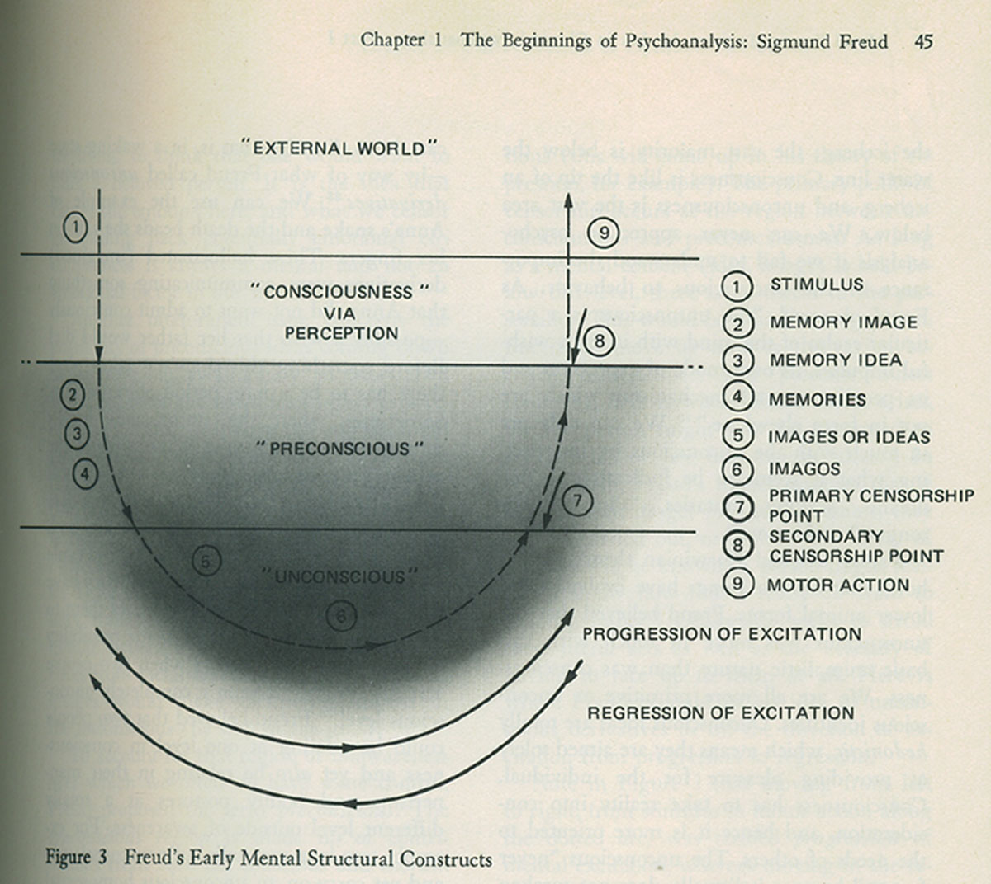

Slide 16
Free Association
Freud was never good with hypnosis, and came to oppose its use as a therapeutic method.
He wanted a method that was better able to overcome resistance, and developed the method of “free association.”
Free association allows the patient to speak of whatever comes to mind. The psychoanalyst, in turn, tries to determine the nature of the unconscious activity from the free associations.

Slide 17
The Free Association Method
Freud had the patient set up in the infamous “shrink’s couch.” Patients lied down, closed their eyes, relaxed, and spoke their thoughts.
Freud focused on issues where the patients showed signs of resistance.
Patients would work with suggestions about as well as when they were hypnotized.
Free Association had the same problems as hypnosis, such as transference, but patients were conscious of the problems.

Slide 18
Freud’s Early Conclusions
He first concluded that all hysteria patients were victims of childhood seduction/ molestation.
“In all 18 cases, I have … come to learn of sexual experiences in childhood.”
Many criticized his results, saying that his method encouraged patients to focus on childhood sexuality and seduction.
Freud eventually abandoned the “childhood seduction” theory, concluding it was all imagined, or memories of childhood fantasies.
100+ years later, we’re still not sure.

Slide 19
Developing Psychoanalysis
After the public reaction to his childhood seduction theory, Freud began a private self-psychoanalysis that lasted two years.
Analyzed behavior, conflicts, sexual urges, dreams, and anything else in his head.
This resulted in his infamous mental model, as well as his most famous work, “The Interpretation of Dreams” (1900). (It was very popular with the public and psychoanalysts, but not with academic psychologists).

Slide 20
Freud’s Mental Model
Id – we are born with the id, which contains the “instincts” and “libido.” (Relates to Darwin’s internal needs for survival and procreation).
Ego – we develop the ego as we become more aware of the difference between our inner urges and our environment. (relates to personality)
Super-ego – the development of conscience, or the “ego-ideal.” Also considered an “ego-potential.” (going from ego to super-ego is like going from a real-self to an ideal-self)

Slide 21
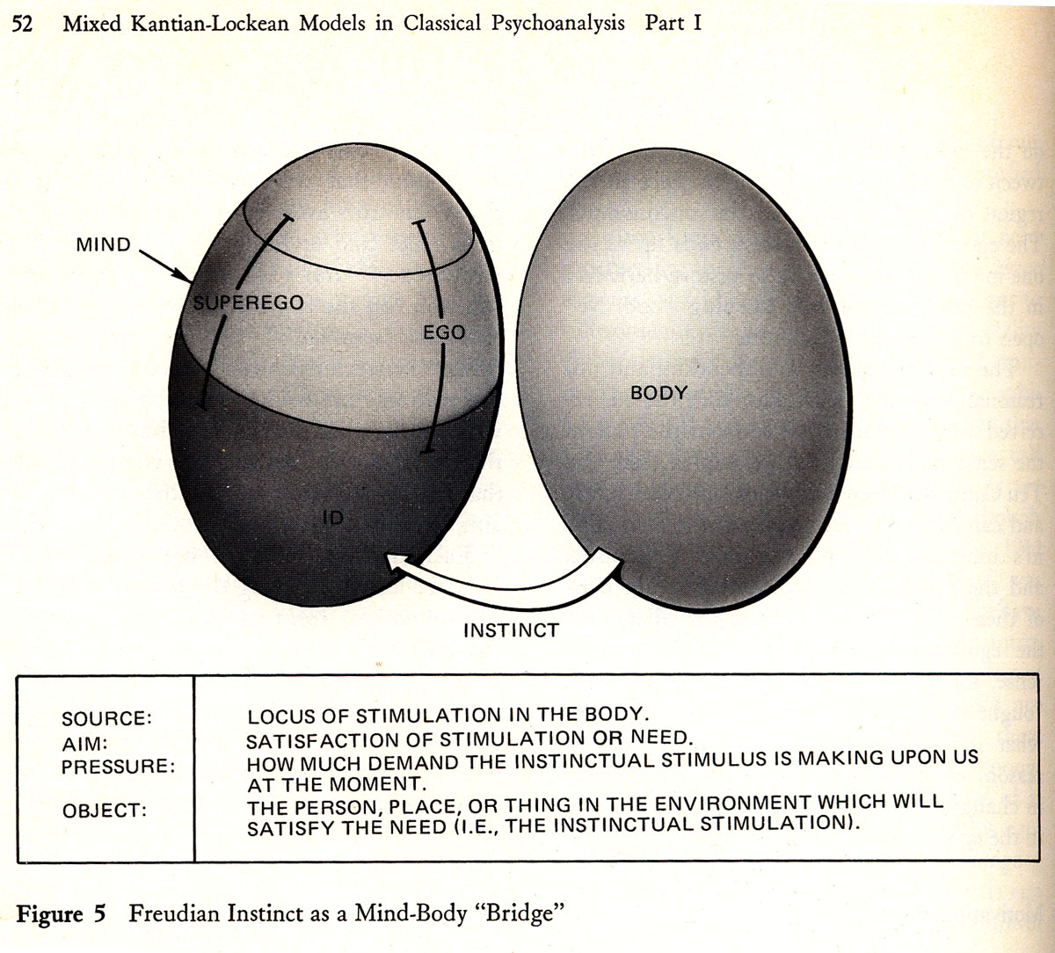

Slide 22
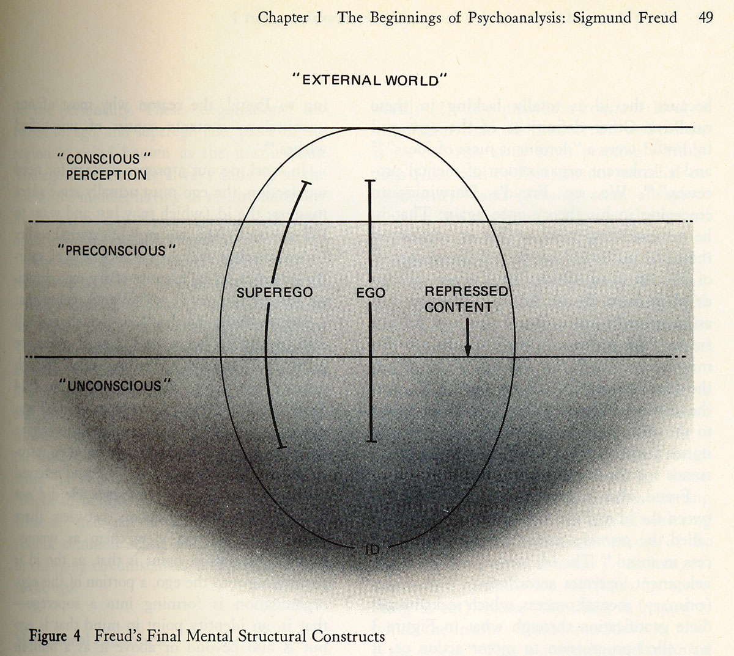

Slide 23
Psychosexual Stages
Freud proposed that the sex-drive (Libido) developed in stages (was the first psychological stage theory).
Oral (0-1) – finding gratification via the mouth.
Anal (1-2) – pleasure in controlling urges. (being anal-retentive leads to a neatness instinct)
Phallic (3-5) – we become aware of pleasure within our sexual organs. We develop sex-roles (men fear castration, women express penis-envy). We also begin to relate to our parents sexually (develop our respective Oedipus/Electra complexes). Ego develops.

Slide 24
Psychosexual Stages
Latency (6-puberty) – we learn to replace our sexual urges with other activities (We learn to sublimate), and we begin developing ego-defense mechanisms, such as
  Repression - most common mechanism
  Rationalization – consciously false justification
  Reaction formation – (for taboos) giving the opposite reaction of instinctive reaction (covering eyes during a movie’s nude scene)
  Others include sublimation, displacement, projection, identification with authority.

Slide 25
Psychosexual Stages
Genital stage (puberty-death) – when puberty hits, the id (and related urges) overcome the latency stage and its mechanisms.
  At this point, a person has unconscious needs (id) rising up to the surface, and meeting the resistance of the defense mechanisms.
  This is where normal and abnormal responses to id urges are developed.
Overall, it is a model of human development, conscience, sexuality, personality, and abnormalities, all in one.

Slide 26
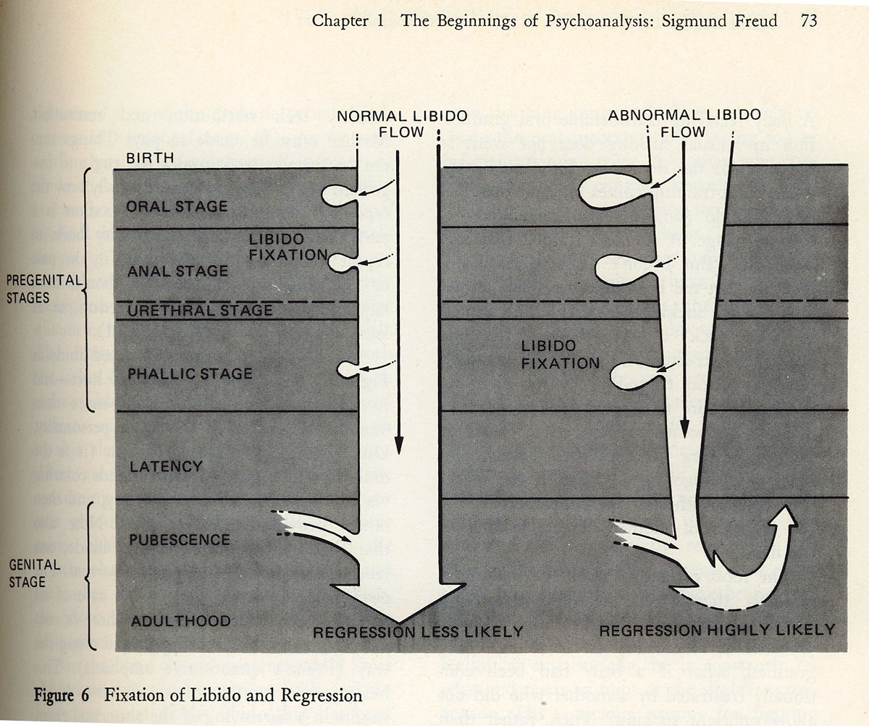

Slide 27
Freud’s Theories of Illness
ANTITHETIC IDEAS & COUNTERWILL
INTENTIONS vs. EXPECTATIONS PROPER
SUBJECTIVE UNCERTAINTY
DISTRESSING ANTITHETIC IDEAS

Slide 28
Sex and Neurosis
COITUS INTERRUPTUS & CHILDHOOD MOLESTATION
Sexual Frustration = Mental illness
Childhood Sexual Molestation = Adult Mental Illness
FREUD’S CORRECTED THESIS
  Actual Past vs. Memories of Fantasies

Slide 29
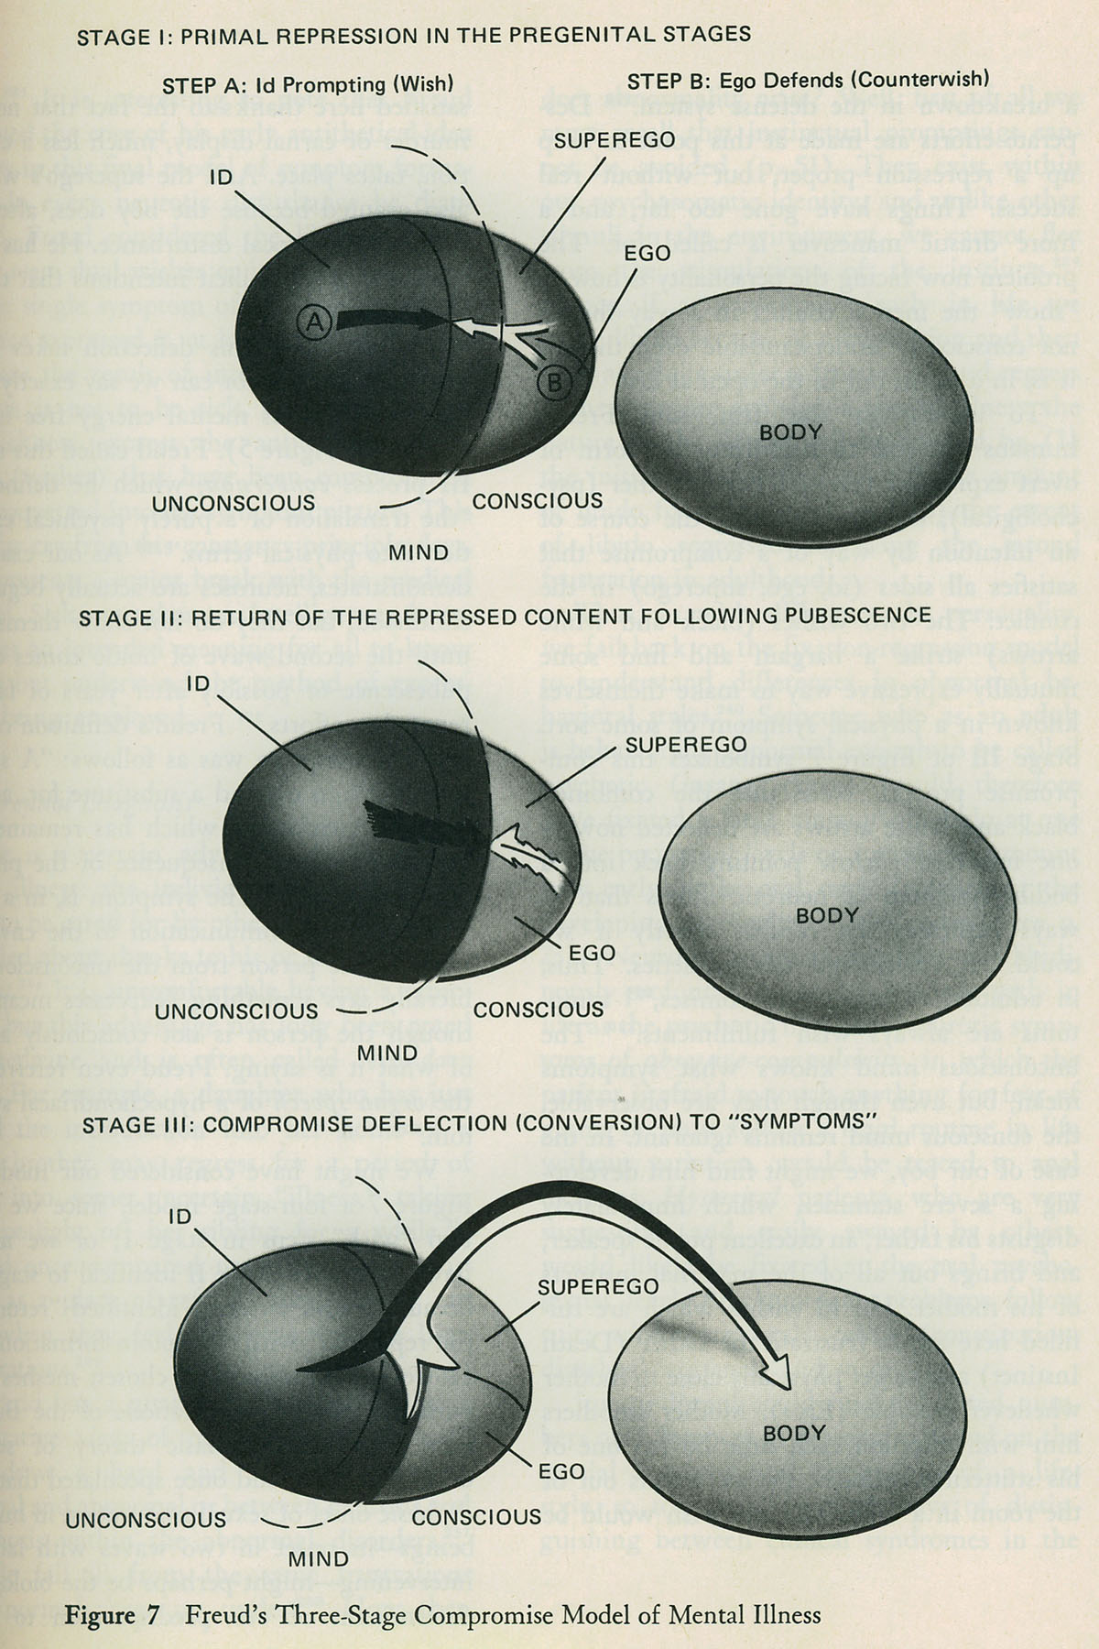
Freud’s Final Theory of Illness

Slide 30
Freud’s Theories of Cure
Role of Insight
A neurotic is suffering from hidden meanings buried deep in the unconscious.
Steps to an insightful understanding for a client
  Determining when and why Primal Repression occurred.
  Assuring patient that a different course of action in life can be taken
  Stressing all the positive changes in client’s life since primal repression.

Slide 31
Freud’s Final Theory of Cure
To be cured the Neurotic must re-enact his Oedipal or her Electra complex in the therapeutic relationship.
Freud called this a “transformed neurosis”, currently called a “transference neurosis”
What’s going on? The neurotic is projecting imagos (figures) from his/her childhood onto the person of the analyst.
What you have is a full blown re-enactment of Oedipal or Electra complex.

Slide 32
How is the Neurotic Cured?
Transference Neurosis
The full- blown re-enactment of the of the Oedipal or Electra complex becomes the vehicle of cure.
The emotions are real.
Positive Transference – love, lust, exaggerated admiration
Negative Transference – hate, disdain, death wishes

Slide 33
How is the Neurotic Cured?
  Flow of Libido
  REPRESSION (Libido used to keep repressed content out of conscious awareness)
  TRANSFERECE (libido used to re-enact Oedipal or Electra drama with analyst as surrogate)
  CURE (liberated Libido is re-invested in client’s ego)

Slide 34
www.youtube.com/watch?v=xDbe0WD-aMI
www.youtube.com/watch?v=xDbe0WD-aMI

Slide 35
Final Comments
Freud made many modifications to his theory as time passed, and other psychoanalysts proposed many, many more changes.
Researchers commonly criticize Freud’s lack of experiments and statistics, as well as the lack of falsifiability in his presentation of theory.
The MOST IMPORTANT criticism, though, asks if Freud is truly overcoming resistance, or merely creating something out of nothing.

